Slide 1


Slide 2

Computer Vision (CV)
Lab5
Object detection
[ YoloV8, YoloV9, Yolo World ]

Slide 3
Object Detection
- Object detection is a phenomenon in computer vision.
- The task of classifying and localizing multiple objects in an image.
- Some of the objects detected include people, cars, chairs ……

Slide 4
Object Detection
• We all know about the image classification problem. Given an image, the Net finds out the class to which the image belongs.
• Localizing an object in a picture means predicting a bounding box around the object and can be expressed as a regression task.

Slide 5
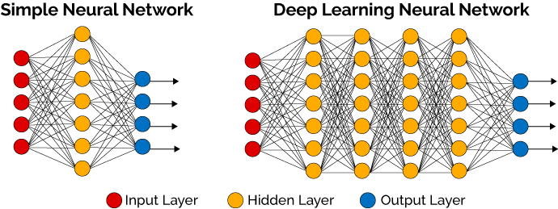
Object Detection - Example
raw image
416*416
image labeling
(C, X,Y, W, H)
model
• Each item should be a tuple of the form :
(images,
(class_labels, bounding_boxes) )
(C, X,Y, W, H)
image result

Slide 6
Object Detection - Example

Slide 7
Object Detection - Example TL

Slide 8
Multiple Objects Detection
In general, object detectors have three (3) main components:
The backbone that extracts features from the given image.
The feature network that takes multiple levels of features from the backbone as input and outputs a list of fused features that represent salient characteristics of the image.
The final class/box network that uses the fused features to predict the class and location of each object.

Slide 9
Object Detection Algorithms
• YOLO (You Only Look Once) Version 3,4,5,6,7,8,9,World
• Single Shot Detector (SSD)
• Fast R-CNN
• Faster R-CNN

Slide 10
What Is Yolo?
You Only Look Once (YOLO) is an algorithm that uses convolutional neural networks for object detection.
It is one of the faster object detection algorithms out there.
It is a very good choice when we need real-time detection, without loss of too much accuracy.

Slide 11
Yolo Steps

Slide 12
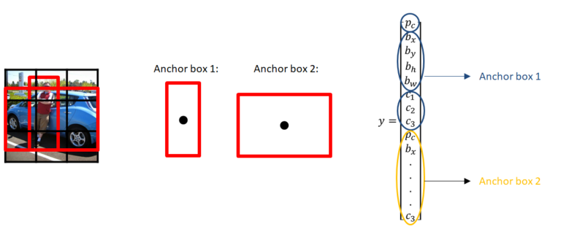
Yolo Steps

Slide 13
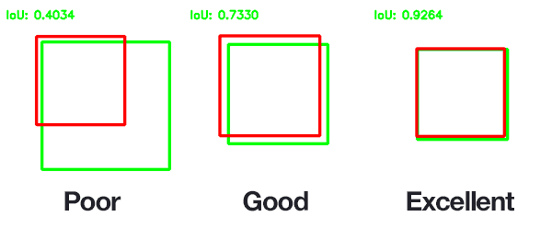
Intersection Over Union (IOU)
It describes how boxes overlap.
Each grid cell is responsible for predicting the bounding boxes and their confidence scores. The IOU is equal to 1 if the predicted bounding box is the same as the real box. This mechanism eliminates bounding boxes that are not equal to the real box.

Slide 14
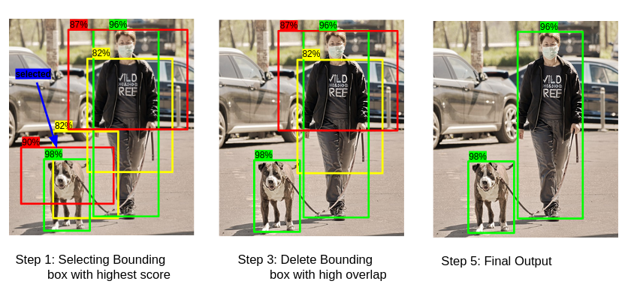
Non-Maximal Suppression
Non-max suppression is the final step of these object detection algorithms and is used to select the most appropriate bounding box for the object.

Slide 15
Yolo Steps
Backbone
refers to the feature-extraction architecture. Tiny YOLO has only 9 convolutional layers, so it’s less accurate but faster and better suited for mobile and embedded projects.
Darknet53 ( The backbone used in YOLOV3) has 53 convolutional layers, so it’s more accurate but slower.
In YOLOv4, backbones can be VGG, ResNet, SpineNet, EfficientNet, ResNeXt, or Darknet53.

Slide 16
Yolo Steps
Neck
additional layers between the backbone and the head (dense prediction block), its purpose is to add extra information in the layers.
Head
The head block is the part used to: locate bounding boxes and classify what’s inside each box.

Slide 17
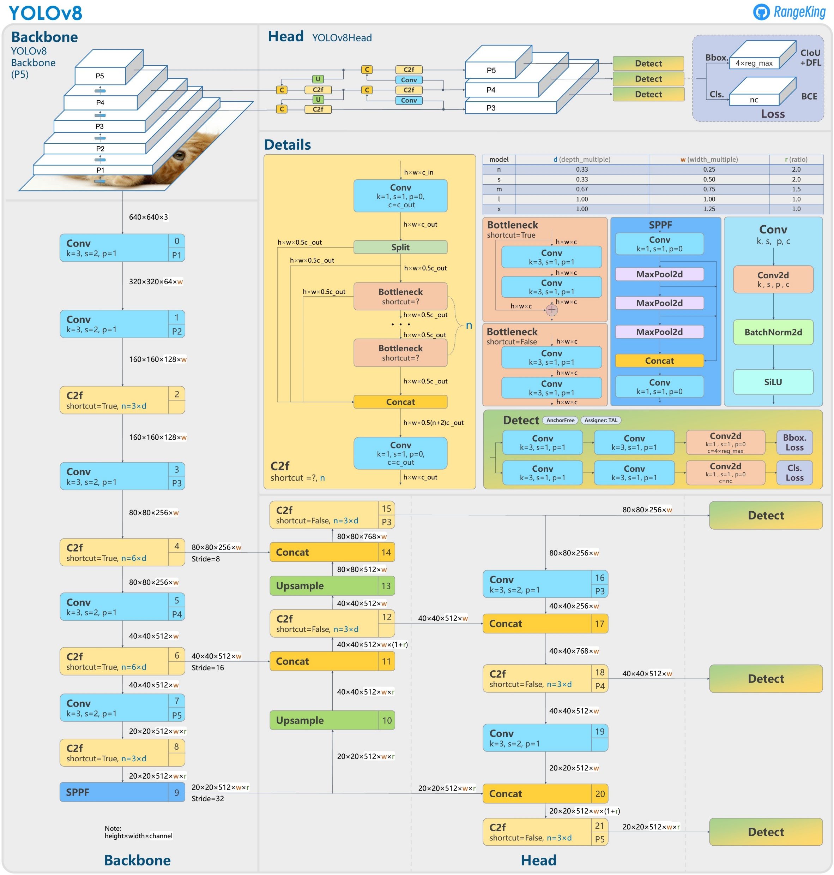
Architecture Of YoloV8
GitHub - ultralytics/ultralytics: NEW - YOLOv8 🚀 in PyTorch > ONNX > OpenVINO > CoreML > TFLite

Slide 18
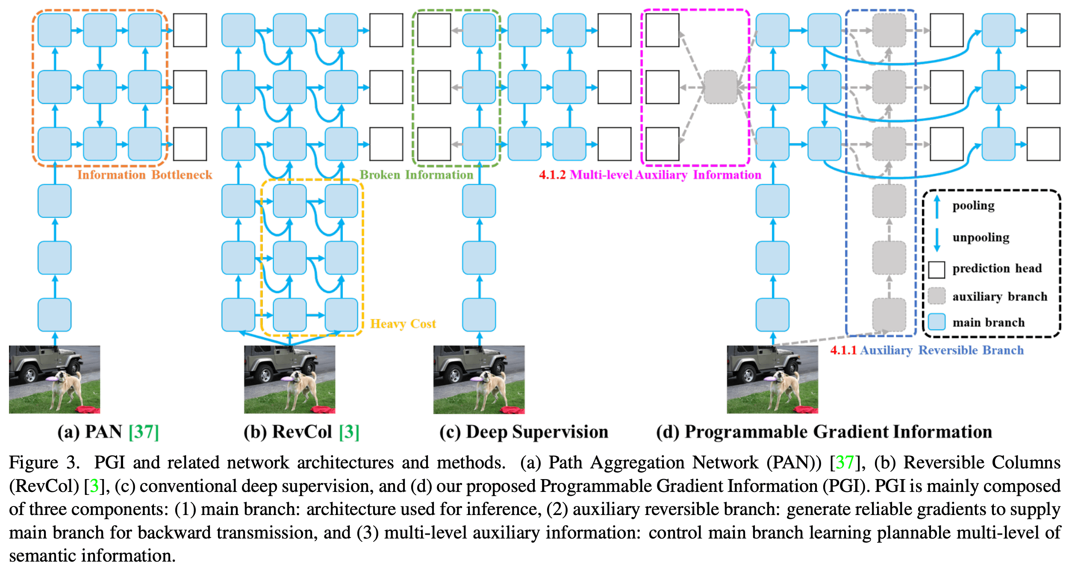
Architecture Of YoloV9
GitHub - WongKinYiu/yolov9: Implementation of paper - YOLOv9: Learning What You Want to Learn Using Programmable Gradient Information

Slide 19
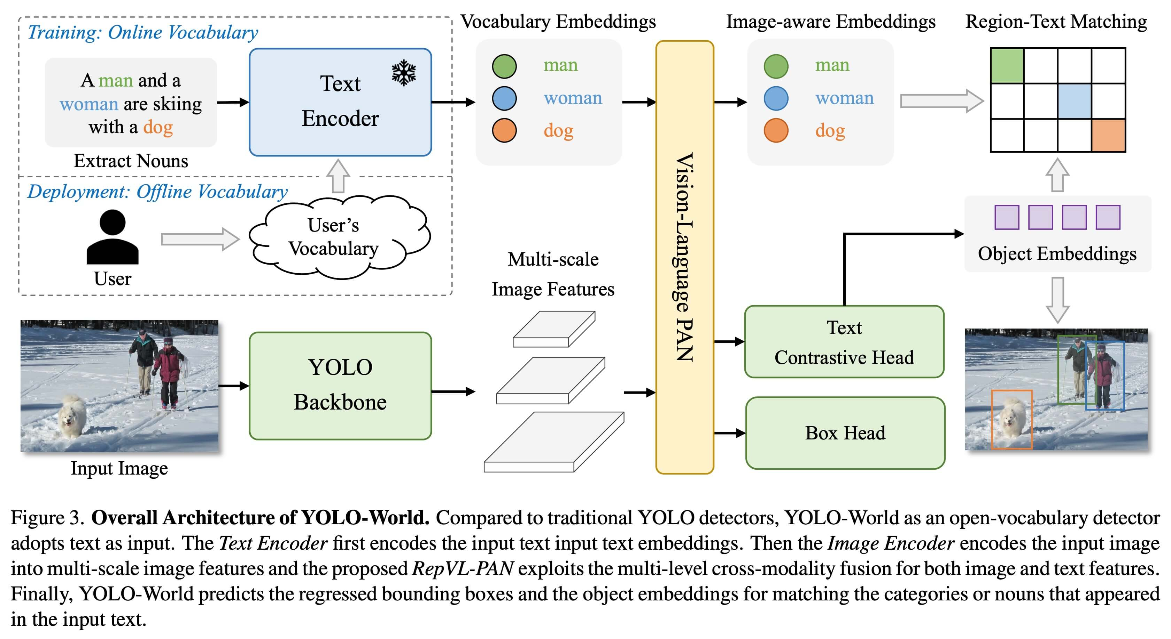
Yolo World
GitHub - AILab-CVC/YOLO-World: [CVPR 2024] Real-Time Open-Vocabulary Object Detection

Slide 20
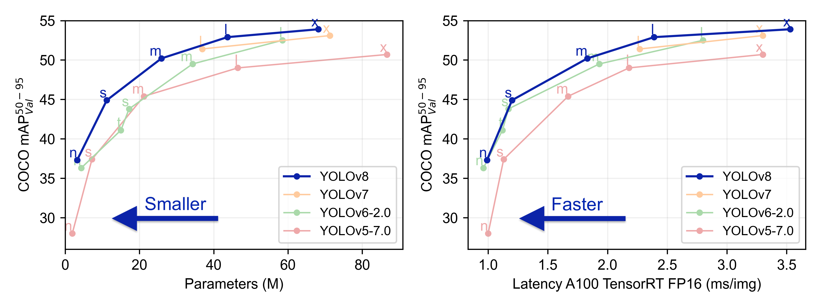
YOLOV8

Slide 21
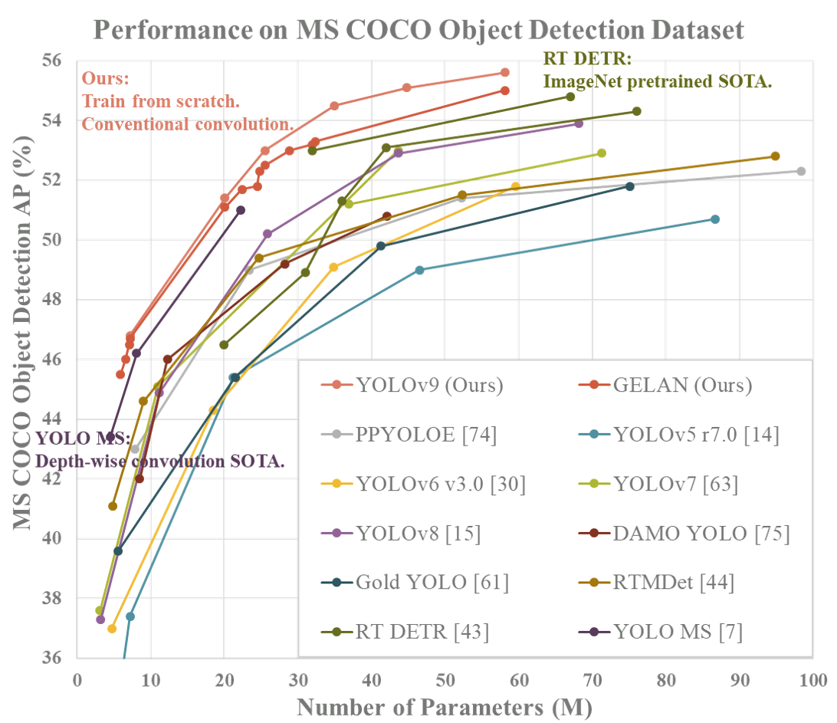
YOLOV9

Slide 22
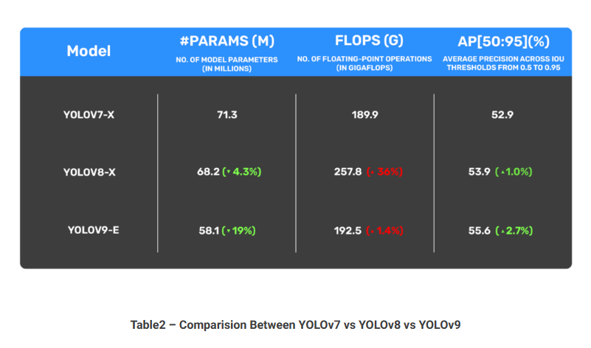
Comparision Between YOLOv7 vs YOLOv8 vs YOLOv9
YOLOv9: Advancing the YOLO Legacy (learnopencv.com)

Slide 23
How To Evaluate Object Detection Model?
• The MSE often works fairly well as a cost function to train the model, but it is not a great metric to evaluate how well the model can predict bounding boxes.
• The most common metric for this is the Intersection over Union (IoU).
Coding : tf.keras.metrics.MeanIoU

Slide 24
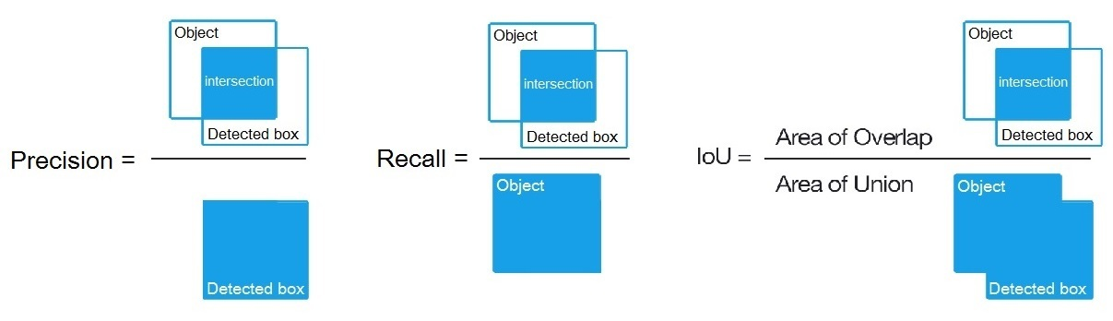
Mean Average Precision ( MAP )
In order to calculate mAP, we draw a series of precision-recall curves with the IoU threshold set at varying levels of difficulty. In COCO evaluation, the IoU threshold ranges from 0.5 to 0.95 with a step size of 0.05 represented as AP@[.5:.05:.95]

Slide 25
Mean Average Precision ( MAP )
• These precision and recall values are then plotted to get a PR (precision-recall) curve. The area under the PR curve is called Average Precision (AP).
• We draw these precision-recall curves for the dataset split out by class type (for example 3 classes and 6 threshold ranges).

Slide 26
Mean Average Precision ( MAP )
• For each class, calculate AP at different IoU thresholds and take their average to get the AP of that class.
• Calculate the final AP by averaging the AP over different classes.
mAP-IoU_thresholds
mAP - example COCO dataset

Slide 27
Labeling Tools

Slide 28
Image Labeling Tool
Open-source image labeling tool like :
VGG Image
Annotator
LabelImg
OpenLabeler
ImgLab

Slide 29
Image Labeling Tool - Labelimg

Slide 31
Train YOLOV8 On A Custom Dataset

Slide 32
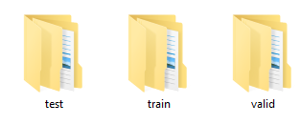
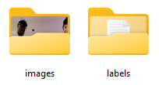
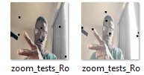
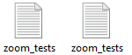
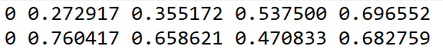
Train YOLOV8 On A Custom Dataset
My dataset
Train set
Train images
Train labels
label

Slide 33
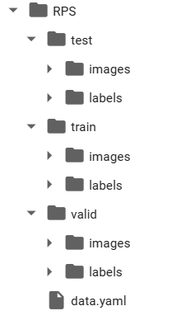
Custom Object Detection Data In YOLOV8 Format – Image and label

Slide 34
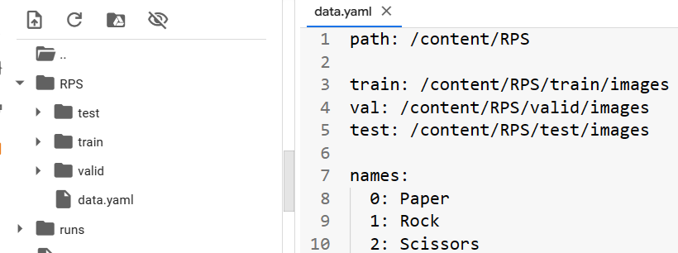
Define Model Configuration And Architecture
We will write a new yaml script file (exp:data.ymal) that defines the parameters for our model like add each class with id and the path of dataset.

Slide 35
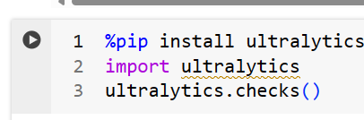
Yolov8 Training
• imgsz: define input image size
• batch: determine batch size
• epochs: define the number of training epochs.
• data: set the path to our yaml file
• mode: train or test or valid
• model: specify a custom path to weights.
• task: detect or classify or segment
• nosave: only save the final checkpoint
• cache: cache images for faster training

Slide 36
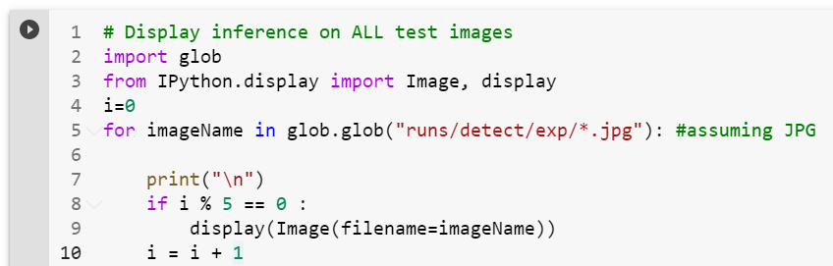
Yolov8 Detection

Slide 37
Train YOLOV9 On A Custom Dataset

Slide 38
Train YOLOV9 On A Custom Dataset
My dataset
Train set
Train images
Train labels
label

Slide 39
Custom Object Detection Data In YOLOV9 Format – Image and label

Slide 40
First Ultralytics

Slide 41
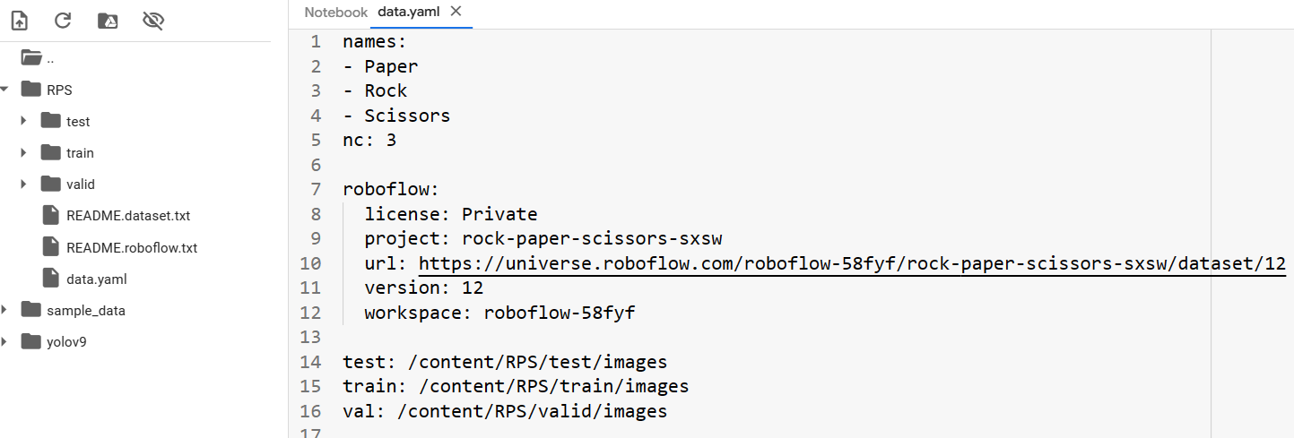
Define Model Configuration And Architecture
We will write a new yaml script file (exp:data.ymal) that defines the parameters for our model like add each class with id and the path of dataset.

Slide 42
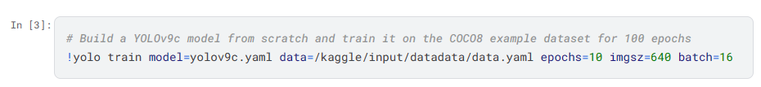
Yolov9 Training
• imgsz: define input image size
• batch: determine batch size
• epochs: define the number of training epochs.
• data: set the path to our yaml file
• mode: train or test or valid
• model: specify a custom path to weights.
• task: detect or classify or segment
• nosave: only save the final checkpoint
• cache: cache images for faster training

Slide 43
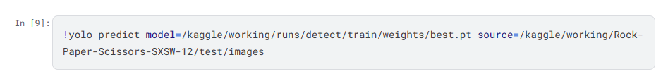
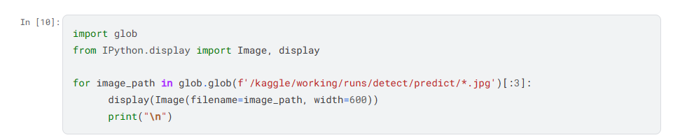
Yolov9 Detection

Slide 44
Second Yolov9-C,E

Slide 45
Define Model Configuration And Architecture
We will write a new yaml script file (exp:data.ymal) that defines the parameters for our model like add each class with id and the path of dataset and change number of classes.

Slide 46
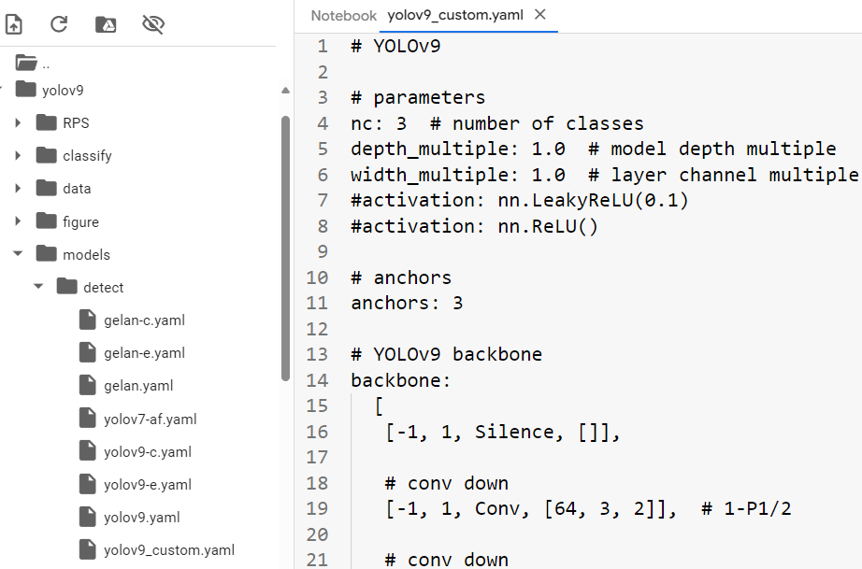
Define Model Configuration And Architecture
We will write a new yaml script file (exp:___.ymal) that defines the parameters for our model like change number of classes.

Slide 47
Yolov9 Training
• img: define input image size
• batch: determine batch size
• epochs: define the number of training epochs.
• data: set the path to our yaml file
• cfg: specify our model configuration
• weights: specify a custom path to weights
• hyp: specify parameters.
• device: GPU (0), cpu

Slide 48
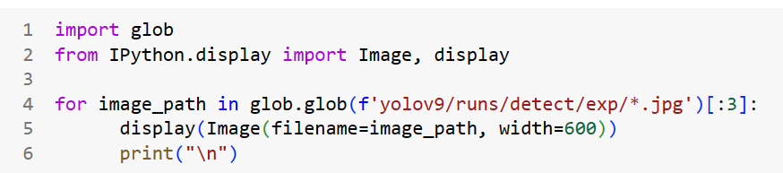
Yolov9 Detection

Slide 49
Third Yolov9 Gelan

Slide 50
Define Model Configuration And Architecture
We will write a new yaml script file (exp:data.ymal) that defines the parameters for our model like add each class with id and the path of dataset and change number of classes.

Slide 51
Define Model Configuration And Architecture
We will write a new yaml script file (exp:___.ymal) that defines the parameters for our model like change number of classes.

Slide 52
Yolov9 Training
• img: define input image size
• batch: determine batch size
• epochs: define the number of training epochs.
• data: set the path to our yaml file
• cfg: specify our model configuration
• weights: specify a custom path to weights
• hyp: specify parameters.
• device: GPU (0), cpu

Slide 53
Yolov9 Detection

Slide 54
Train DETRS On A Custom Dataset

Slide 55
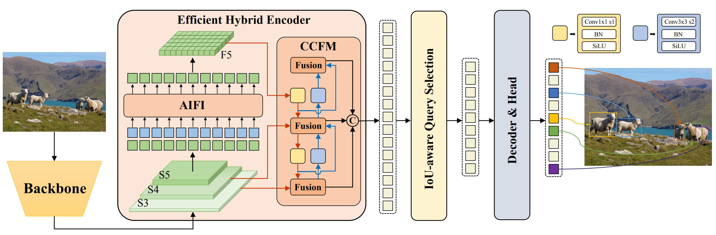
https://arxiv.org/pdf/2304.08069.pdf

Slide 56
Train YOLOV8 On A Custom Dataset
My dataset
Train set
Train images
Train labels
label

Slide 57
Custom Object Detection Data In YOLOV8 Format – Image and label

Slide 58
Define Model Configuration And Architecture
We will write a new yaml script file (exp:data.ymal) that defines the parameters for our model like add each class with id and the path of dataset.

Slide 59
Yolov8 Training
• imgsz: define input image size
• batch: determine batch size
• epochs: define the number of training epochs.
• data: set the path to our yaml file
• mode: train or test or valid
• model: specify a custom path to weights.
• task: detect or classify or segment
• nosave: only save the final checkpoint
• cache: cache images for faster training

Slide 60
Yolov8 Detection

Slide 61
Thanks for listening

